Slide 1

Pharmaceutical Sales prediction across multiple stores

Slide 2
Data fields
Most of the fields are self-explanatory. The following are descriptions for those that aren't.
Id - an Id that represents a (Store, Date) duple within the test set
Store - a unique Id for each store
Sales - the turnover for any given day (this is what you are predicting)
Customers - the number of customers on a given day
Open - an indicator for whether the store was open: 0 = closed, 1 = open
StateHoliday - indicates a state holiday. Normally all stores, with few exceptions, are closed on state holidays. Note that all schools are closed on public holidays and weekends. a = public holiday, b = Easter holiday, c = Christmas, 0 = None
SchoolHoliday - indicates if the (Store, Date) was affected by the closure of public schools
StoreType - differentiates between 4 different store models: a, b, c, d
Assortment - describes an assortment level: a = basic, b = extra, c = extended.
CompetitionDistance - distance in meters to the nearest competitor store
CompetitionOpenSince[Month/Year] - gives the approximate year and month of the time the nearest competitor was opened
Promo - indicates whether a store is running a promo on that day
Promo2 - Promo2 is a continuing and consecutive promotion for some stores: 0 = store is not participating, 1 = store is participating
Promo2Since[Year/Week] - describes the year and calendar week when the store started participating in Promo2
PromoInterval - describes the consecutive intervals Promo2 is started, naming the months the promotion is started anew. E.g. "Feb,May,Aug,Nov" means each round starts in February, May, August, November of any given year for that store

Slide 3
Store Data all relevant variables and associated data types
RangeIndex: 1115 entries, 0 to 1114
Data columns (total 10 columns):
# Column Non-Null Count Dtype
0 Store 1115 non-null int64
1 StoreType 1115 non-null object
2 Assortment 1115 non-null object
3 CompetitionDistance 1112 non-null float64
4 CompetitionOpenSinceMonth 761 non-null float64
5 CompetitionOpenSinceYear 761 non-null float64
6 Promo2 1115 non-null int64
7 Promo2SinceWeek 571 non-null float64
8 Promo2SinceYear 571 non-null float64
9 PromoInterval 571 non-null object

Slide 4
Train Data all relevant variables and associated data types
RangeIndex: 1017209 entries, 0 to 1017208
Data columns (total 9 columns):
# Column Non-Null Count Dtype
0 Store 1017209 non-null int64
1 DayOfWeek 1017209 non-null int64
2 Date 1017209 non-null object
3 Sales 1017209 non-null int64
4 Customers 1017209 non-null int64
5 Open 1017209 non-null int64
6 Promo 1017209 non-null int64
7 StateHoliday 1017209 non-null object
8 SchoolHoliday 1017209 non-null int64
dtypes: int64(7), object(2)

Slide 5
Test Data all relevant variables and associated data types
RangeIndex: 1017209 entries, 0 to 1017208
Data columns (total 9 columns):
# Column Non-Null Count Dtype
0 Store 1017209 non-null int64
1 DayOfWeek 1017209 non-null int64
2 Date 1017209 non-null object
3 Sales 1017209 non-null int64
4 Customers 1017209 non-null int64
5 Open 1017209 non-null int64
6 Promo 1017209 non-null int64
7 StateHoliday 1017209 non-null int8
8 SchoolHoliday 1017209 non-null int64

Slide 6
Exploratory Data Analysis (EDA)
Found Null values in Store Data
Found Null values in Test Data
Column Null Value
Store 0
StoreType 0
Assortment0 0
CompetitionDistance 0
CompetitionOpenSinceMonth 354
CompetitionOpenSinceYear 354
Promo2 0
Promo2SinceWeek 544
Promo2SinceYear 544
PromoInterval 544
Column Null Value
Id 0
Store 0
DayOfWeek 0
Date 0 Open 11
Promo 0
StateHoliday 0
SchoolHoliday 0

Slide 7
Basic metrics (mean, median, MODE)
MEAN- The "average" number; found by adding all data points and dividing by the number of data points.
MEDIAN- The middle number; found by ordering all data points and picking out the one in the middle (or if there are two middle numbers, taking the mean of those two numbers).
MODE- The most frequent number—that is, the number that occurs the highest number of times.
All the Null values filled by mean value & categorical Null values filled by mode value

Slide 8
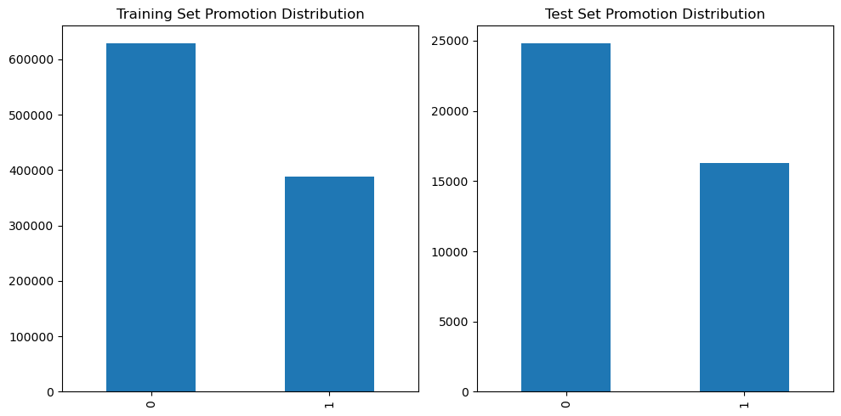
Task 1 - Exploration of customer purchasing behavior
Check for distribution in both training and test sets - are the promotions distributed similarly between these two groups?

Slide 9
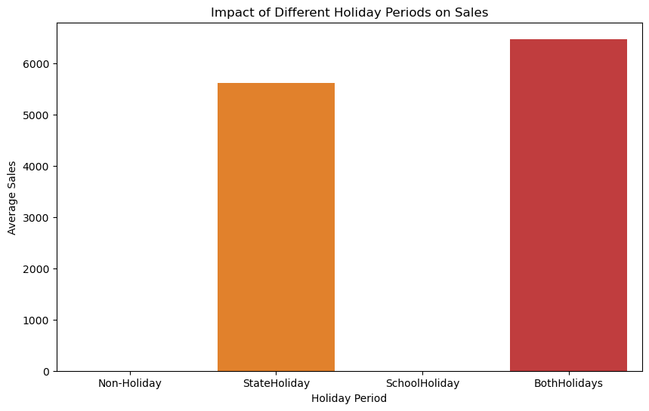
Check & compare sales behavior before, during and after holidays

Slide 10
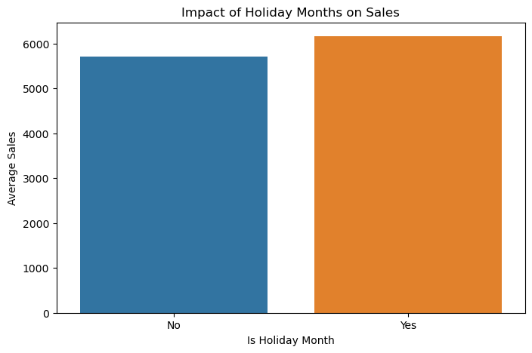
Find out any seasonal (Christmas, Easter etc) purchase behaviors

Slide 11
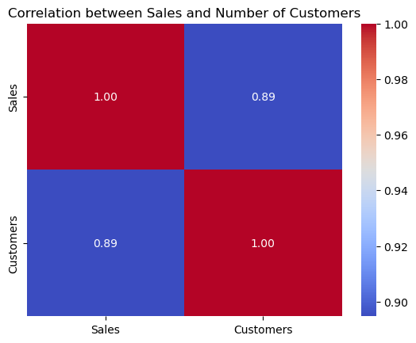
What can you say about the correlation between sales and number of customers?

Slide 12
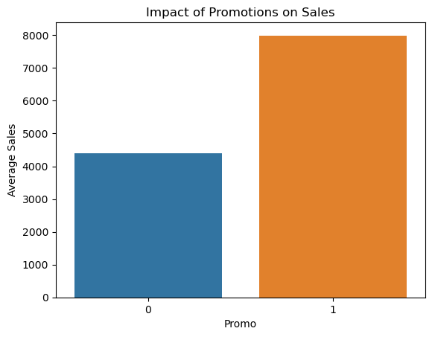
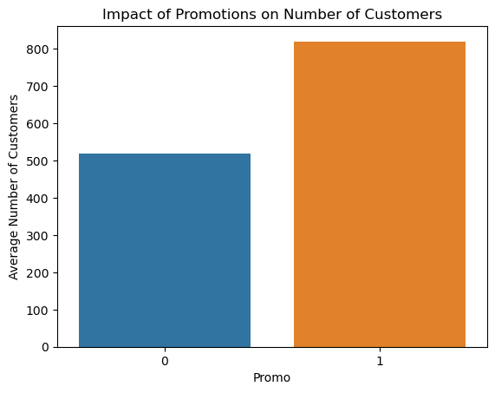
How does promo affect sales? Are the promos attracting more customers? How does it affect already existing customers?
1. The DataFrame is grouped by the 'Promo' column to calculate the mean sales and the mean number of customers for each promo status.
2. Two bar plots are created: one for the impact of promotions on sales and another for the impact on the number of customers.
3. The resulting visualizations will help you understand how promotions are correlated with average sales and the average number of customers. Positive impacts on sales and an increase in the number of customers during promotions may suggest that the promotions are effective.

Slide 13
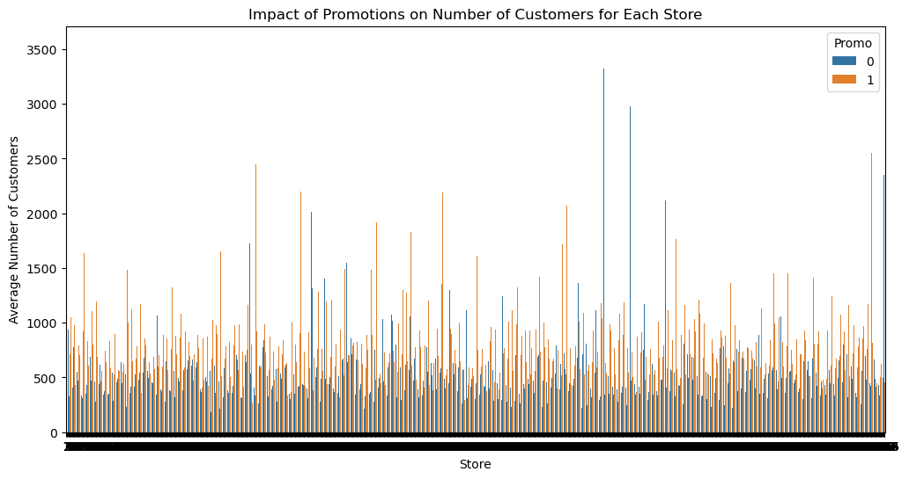
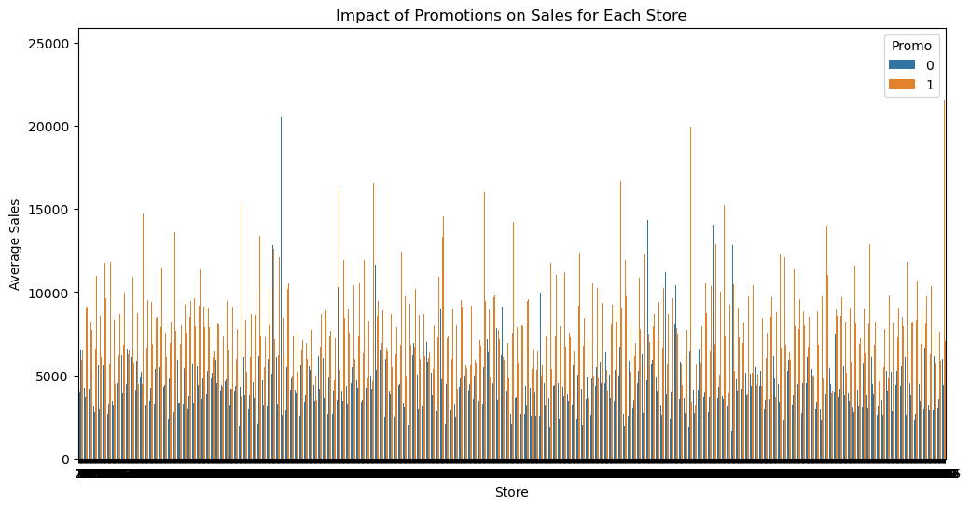
Could the promos be deployed in more effective ways? Which stores should promos be deployed in?
1. The DataFrame is grouped by both 'Store' and 'Promo' columns to calculate the mean sales and the mean number of customers for each store and promo status.
2. Two bar plots are created: one for the impact of promotions on sales for each store and another for the impact on the number of customers for each store.
3. These visualizations will help you identify which stores benefit the most from promotions and which ones may need adjustments in their promotional strategies. If certain stores consistently show positive impacts from promotions, you may consider deploying promotions more frequently or intensively in those stores.

Slide 14
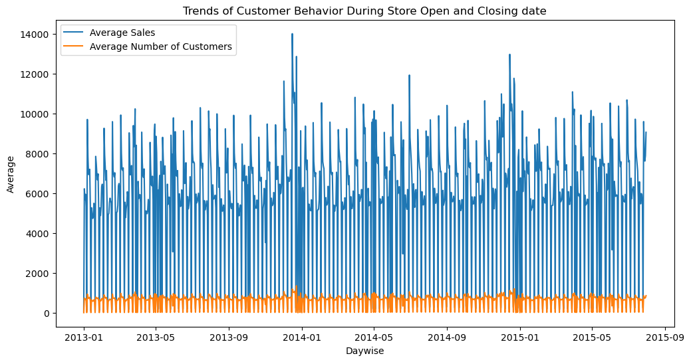
Trends of customer behavior during store open and closing times
1. The 'Date' column is converted to a datetime format
2. The DataFrame is then grouped by the hour of the day to calculate the mean sales and the mean number of customers for each day.
3. A line plot is created to visualize the trends during store open and closing.
4. This visualization will help you understand how customer behavior (both in terms of sales and the number of customers) varies throughout the day. You can observe peak days, identify trends during opening and closing day, and adjust staffing or promotional strategies accordingly.

Slide 15
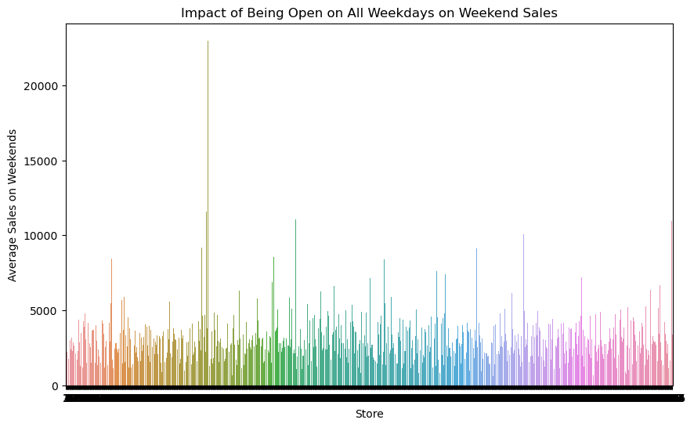
Which stores are opened on all weekdays? How does that affect their sales on weekends?

Slide 16
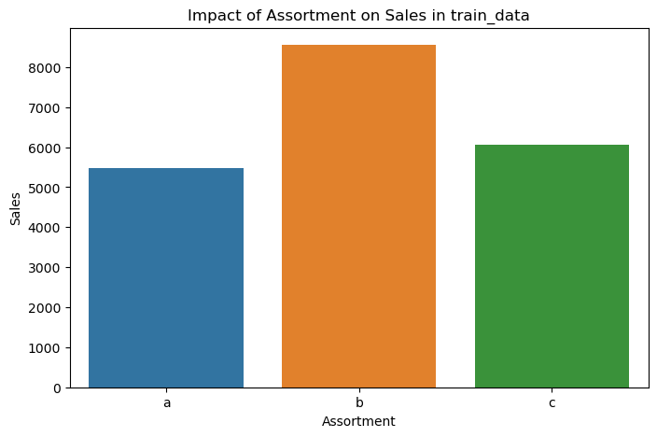
Check how the assortment type affects sales

Slide 17
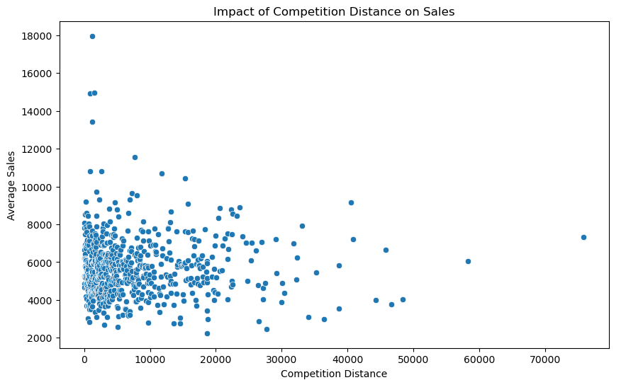
How does the distance to the next competitor affect sales? What if the store and its competitors all happen to be in city centres, does the distance matter in that case?

Slide 18
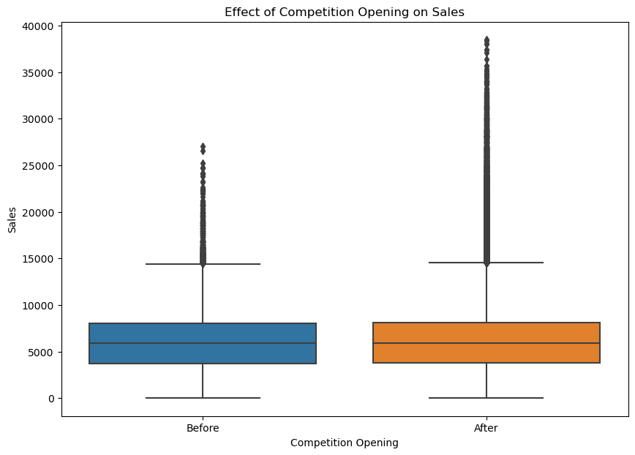
How does the opening or reopening of new competitors affect stores? Check for stores with NA as competitor distance but later on has values for competitor distance

Slide 19
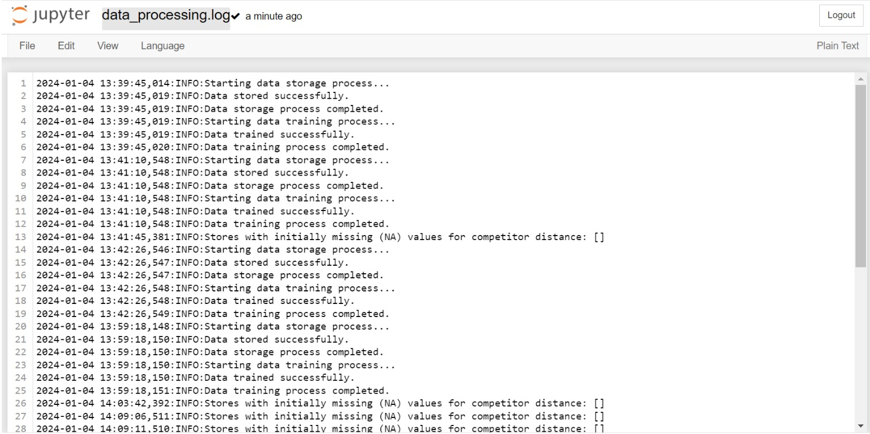
1.2 - Logging
Log your steps using the logger library in python.

Slide 20
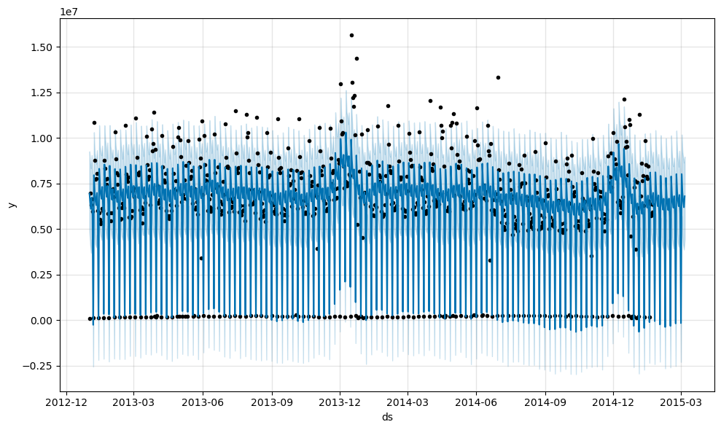
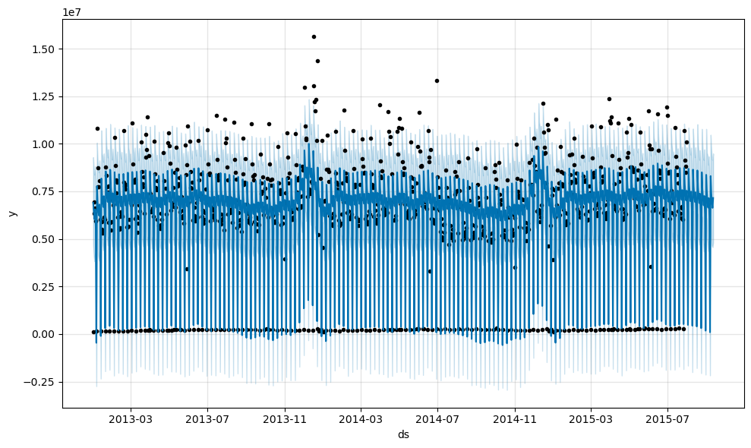
Task 2 - Prediction of store sales
Prediction of sales is the central task in this challenge. you want to predict daily sales in various stores up to 6 weeks ahead of time. This will help the company plan ahead of time.

Slide 21
Here's a basic outline of the steps you might follow:
1.Data Preprocessing:
Ensure that your date column is in datetime format. Explore the data and handle missing values. Aggregate the sales data by day if it's not already in that form.
2.Feature Engineering:
Extract relevant features from the date, such as day of the week, month, and year. Consider incorporating external factors that might influence sales, such as holidays, promotions, etc. Train-Test Split:
Split your data into training and testing sets. The training set should include the historical sales data, and the testing set should be the period you want to predict.
3.Model Selection:
Choose a time series forecasting model. Popular choices include ARIMA, SARIMA, Prophet, and machine learning models like XGBoost, LSTM, or GRU.
4.Model Training:
Train your selected model using the training set. Tune hyper parameters if necessary.
5.Model Evaluation:
Evaluate the model's performance on the testing set using appropriate metrics (e.g., Mean Absolute Error, Mean Squared Error).
6.Prediction:
Use the trained model to make predictions for the next 6 weeks.
7.Visualization:
Visualize the predicted sales against the actual sales to assess the model's performance.

